Slide 1
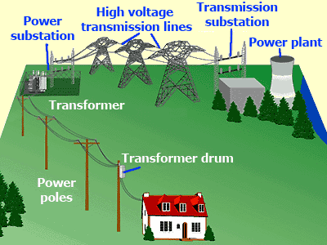
Module 5
Power Transmission and distribution

Slide 2
Contents-Unit Objectives
Power transmission and distribution: Concept of power transmission and power distribution. Low
voltage distribution system (400 V and 230 V) for domestic, commercial and small scale industry
through block diagrams only.
Electricity bill: Power rating of household appliances including air conditioners, PCs, laptop, printer
etc. Definition of “unit” used for consumption of electrical energy, two - part electricity tariff,
calculation of electricity bill for domestic consumers.
Equipment Safety measures: Working principle of Fuse and Miniature circuit breaker (MCB),
merits and demerits.
Personal safety measures: Electric Shock, Earthing and its types, Safety Precautions to avoid shock
and Residual Current Circuit Breaker (RCCB).

Slide 3
Introduction
The generation, transmission and distribution of electrical energy started with direct current
During the 1880s and 1890s, the introduction of transformers, poly- phase circuits, and the induction motor changed the AC power system
The DC generators were replaced with three phase ac generators (often referred to as Synchronous generators) due to the following constraints
Voltage per commutator segment is limited to about 20V in order to avoid sparking between segments
Commutator and brush maintenance.

Slide 4
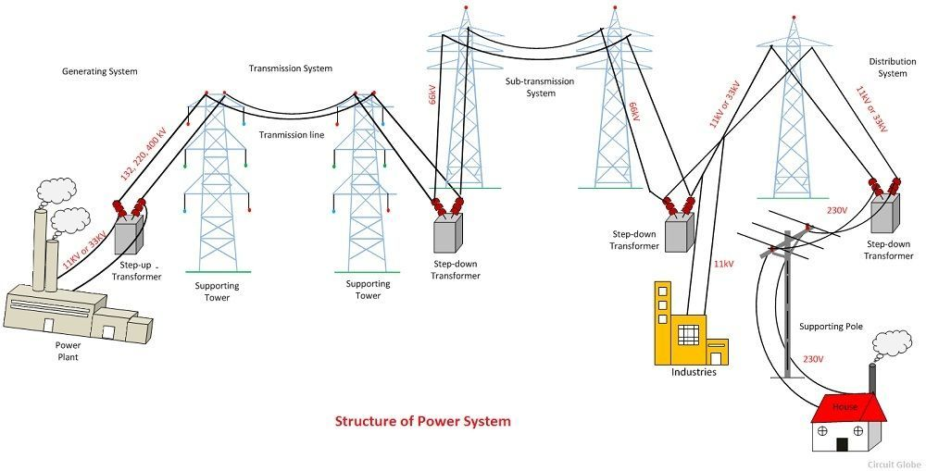
Electrical Power Supply system

Slide 5
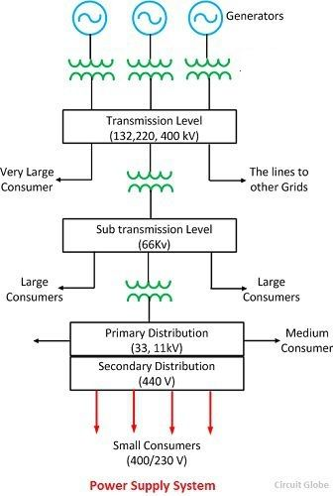
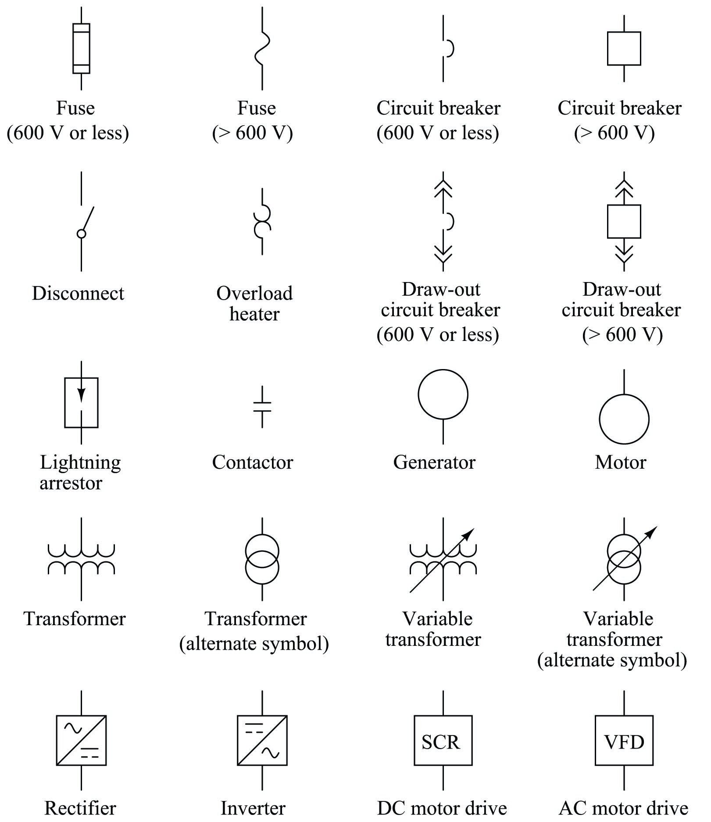
Block diagram of a typical a.c. power supply scheme

Slide 6
Schematic diagram of 3-phase, 4 wire distribution system

Slide 7
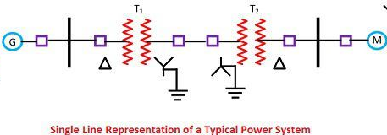
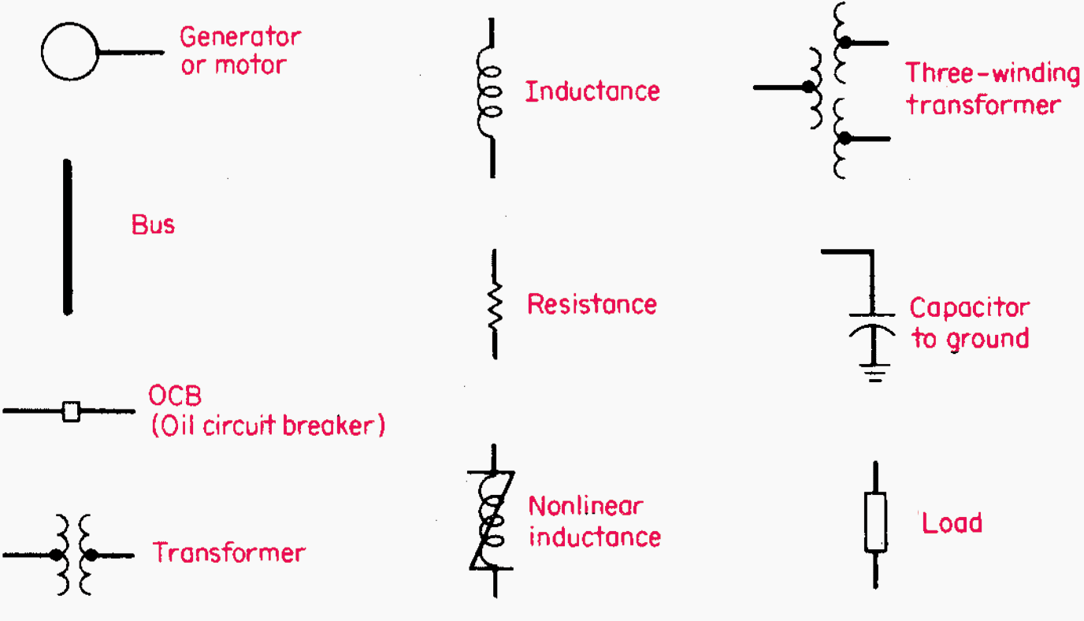
Single line diagram is the representation of a power system using the simple symbol for each component

Slide 8
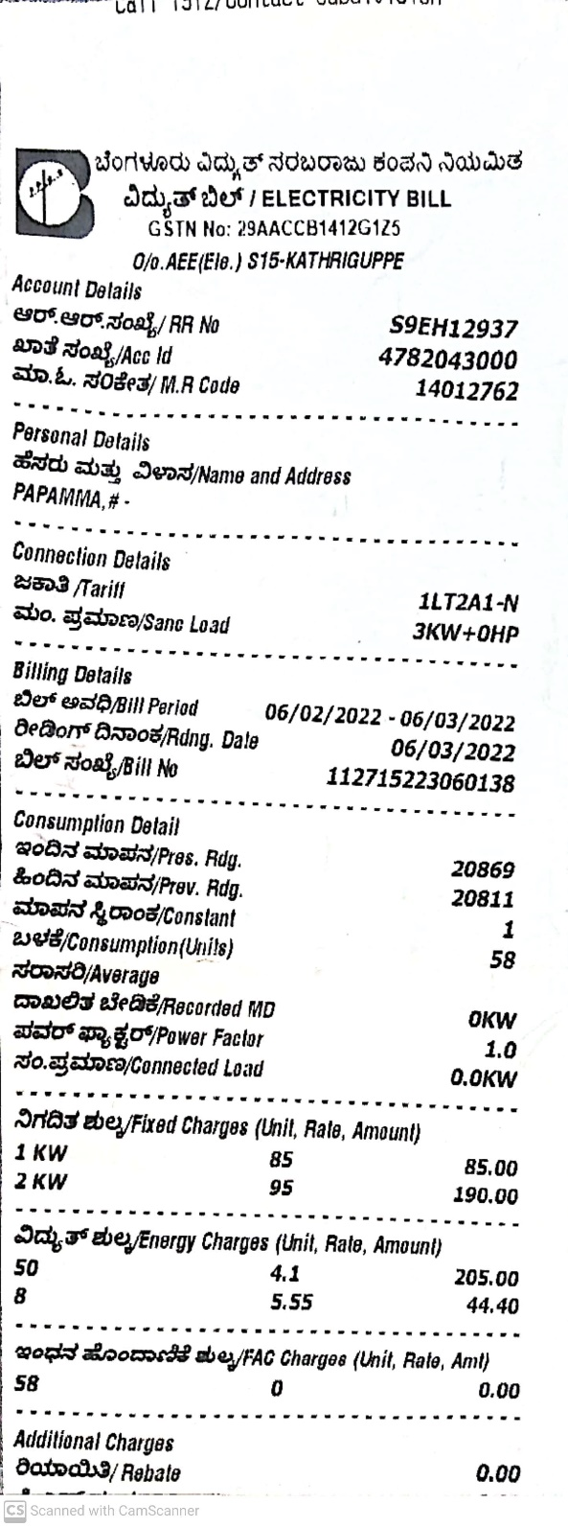

Electricity bill

Slide 9
Tariff
Rate at which electrical energy is sold to the consumers is termed as ‘tariff.’
Desirable characteristics of a tariff
The tariff should be such that the total cost of generation, transmission, and distribution is recovered.
It should earn a reasonable profit.
It must be fair and at a reasonable to the consumers.
It should be simple and easy to apply.
It should be attractive than a competitor.
The electric energy used by a 100 watt light bulb operating for 24 hours is (100 watts) × (24 hours) / (1000 watt hours/kWh) = 2.4 kWh.
The typical cost of 1 kWh of electric energy from BESSCOM is Rs.3.75 .
Thus 2.4 kWh of electric energy costs (2.4 kWh) × ( 3.75 /kWh) = Rs. 9/-

Slide 10
Electricity Tariff
The electric power required by an electric appliance can be estimated as
(the appliance's electric CURRENT) × (the VOLTAGE across its terminals).
if the current through a household light bulb is 0.5 amperes and the voltage across its filament is the common 230 volts,
Then
its power is (0.5 amperes) ×(230 volts)
= 115 ampere volts
= 115 watts.

Slide 12
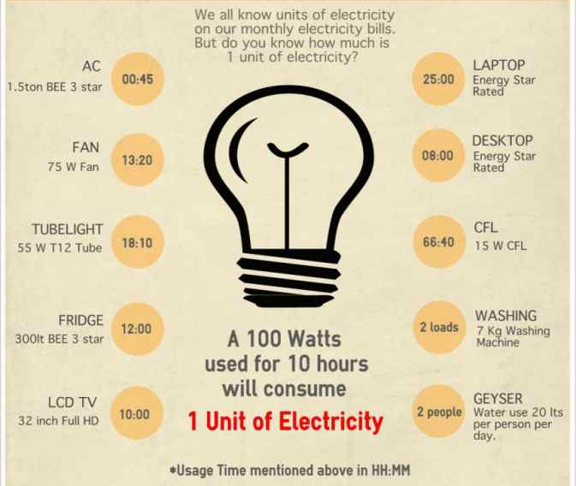

Slide 13
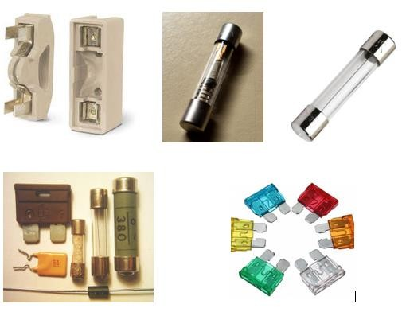
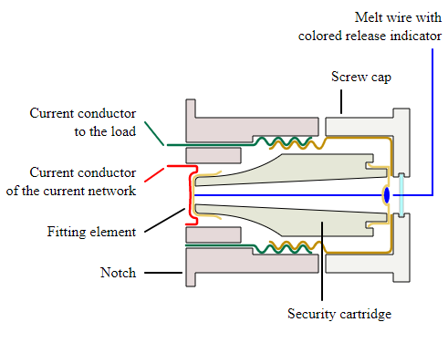
Equipment Safety measures
Different types of fuses

Slide 14
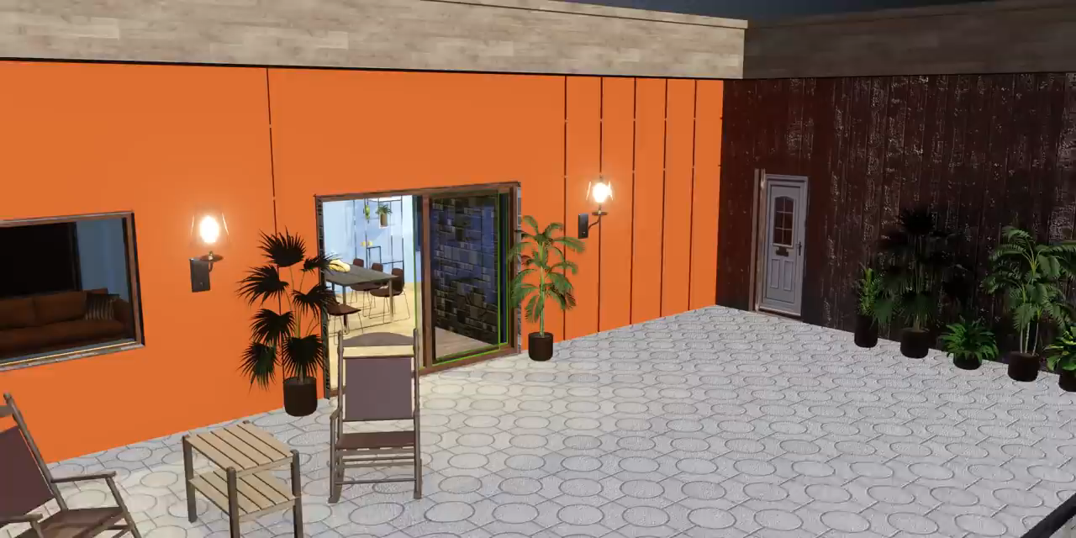
Equipment Safety measures

Slide 15
Working of a fuse
An electric fuse is based on the principle of heating effect of electric current. When an excessive current flows in the circuit, it generates heat in the circuit which leads to melt the fuse due to its low melting point, and it also opens the circuit.
Functions of the fuse are:
• Prevents device failure due to faulty circuit operation
• Prevents overload and blackouts
• Fuse prevents short-circuits
• Prevents damage that is caused due to mismatched loads

Slide 16
A fuse consists of a metal strip or wire fuse element, of small cross-section compared to the circuit conductors, mounted between a pair of electrical terminals, and (usually) enclosed by a non-combustible housing.
The fuse is arranged in series to carry all the current passing through the protected circuit.
The resistance of the element generates heat due to the current flow.
The size and construction of the element is (empirically) determined so that the heat produced for a normal current does not cause the element to attain a high temperature.
If very high current flows, the element rises to a higher temperature and either directly melts, or else melts a soldered joint within the fuse, opening the circuit.
The fuse element is made of zinc, copper, silver, aluminium, or alloys among these or other various metals to provide stable and predictable characteristics.
The fuse ideally would carry its rated current indefinitely, and melt quickly on a small excess. The element must not be damaged by minor harmless surges of current, and must not oxidize or change its behaviour after possibly years of service.

Slide 17
Advantages of Fuse:
✓ Fuses are the cheapest form of protection.
✓ The fuse element change very easily.
✓ The fuse needs zero maintenance.
✓ It affords the current limiting effect under short circuit conditions.
✓ Its operation is completely automatic and requires less time as compared to circuit breakers and no complexity is involved
✓ Most of the fuses are self-protecting
Disadvantages of fuse:
It is not suitable for overload, at that time fuse blow off replacing of fuse takes time. During this period of lost power.
The protection of fuse is not reliable.
Low breaking capacity.
Fuse is slow compared to circuit breakers. It is a slow speed.

Slide 18
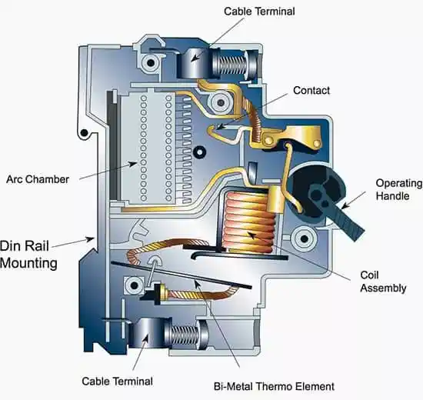
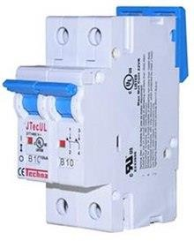
Miniature Circuit Breaker

Slide 19
Actuator lever - used to manually trip and reset the circuit breaker. Also indicates the status of the circuit breaker (On or Off/tripped).
Actuator mechanism - forces the contacts together or apart.
Contacts - allow current when touching and break the current when moved apart.
Terminals
Bimetallic strip - separates contacts in response to smaller, longer-term overcurrent
Calibration screw - allows the manufacturer to precisely adjust the trip current of the device after assembly.
Solenoid - separates contacts rapidly in response to high overcurrent
Arc divider/extinguisher

Slide 20
Difference between fuse and circuit breaker
Fuse works on the principle of electrical and thermal properties of the conducting materials whereas the circuit breakers work on the electromagnetism and switching principle.
The fuse provides protection against only power overloads whereas a circuit breaker provides protection for both power
overload and short circuit.
Breaking the capacity of the fuse is low as compared to that of a circuit breaker.
The fuse provides both detection and interruption process. Circuit breaker performs the only interruption, a relay system is attached for detection of any fault in the circuit.
No auxiliary contact is required in case of fuse but in circuit breaker, auxiliary contact is required.
Operating time of fuse is very less about 0.002 second while operating time of circuit breaker is comparatively more than that of fuse, about 0.02 to 0.05 second.
Fuse cannot be used as an ON/OFF switch while in circuit breaker can be used as an ON/OFF as a switch.
Fuse is only single pole version is available while in circuit breaker single and multiple pole version is available.

Slide 21
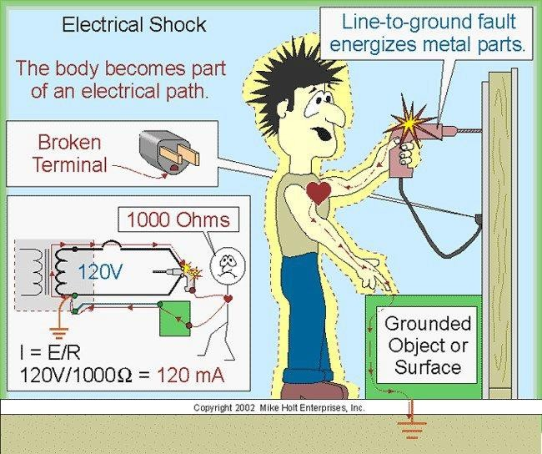
Personal safety measures

Slide 22
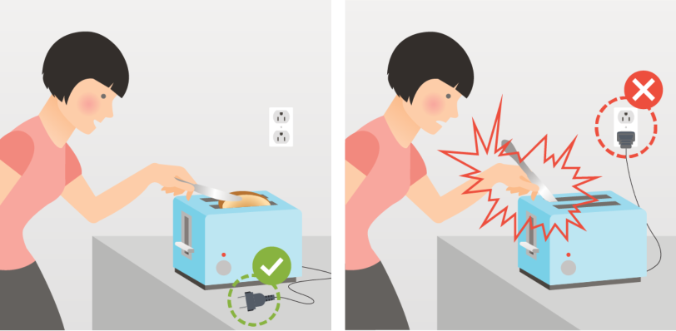
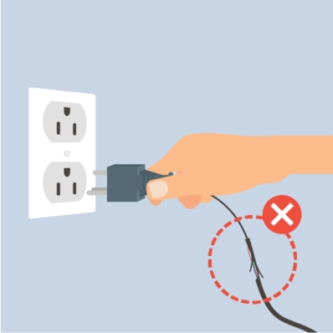
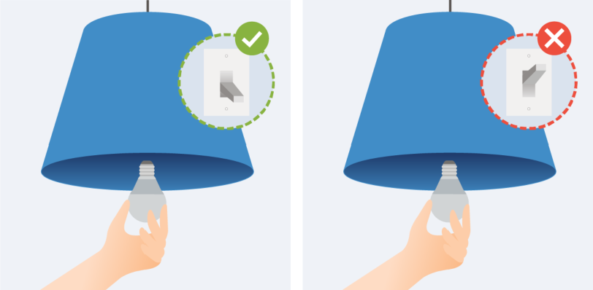
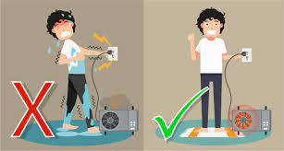
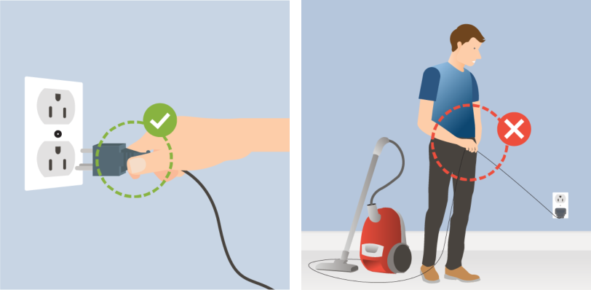
Never take risks with electricity!

Slide 23
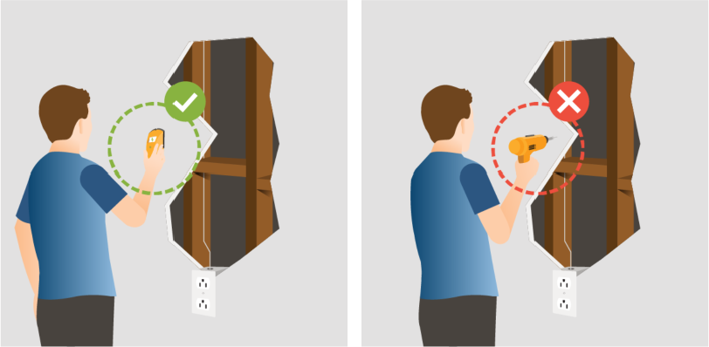
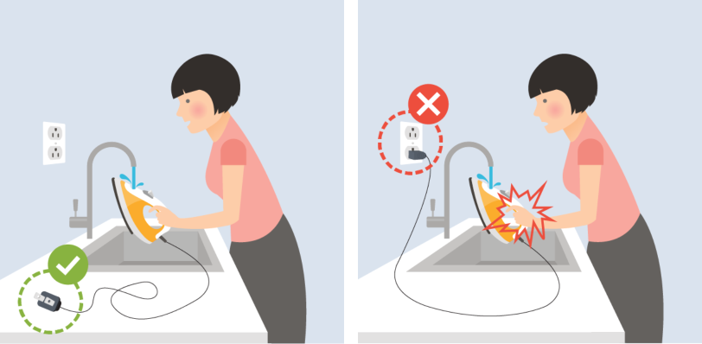
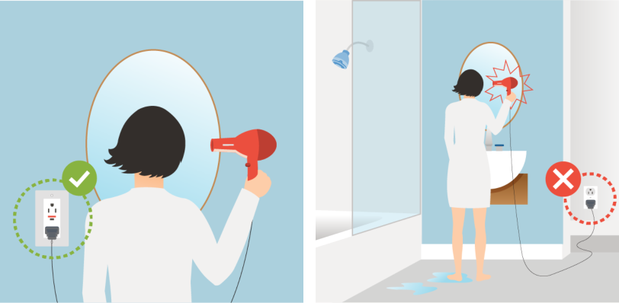
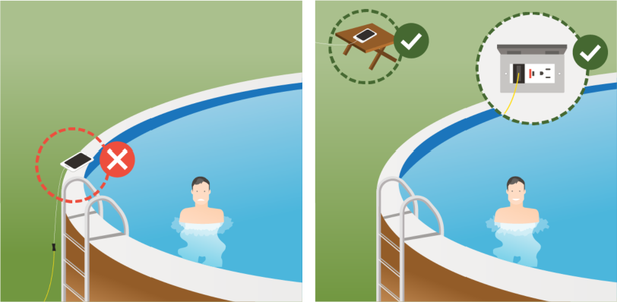
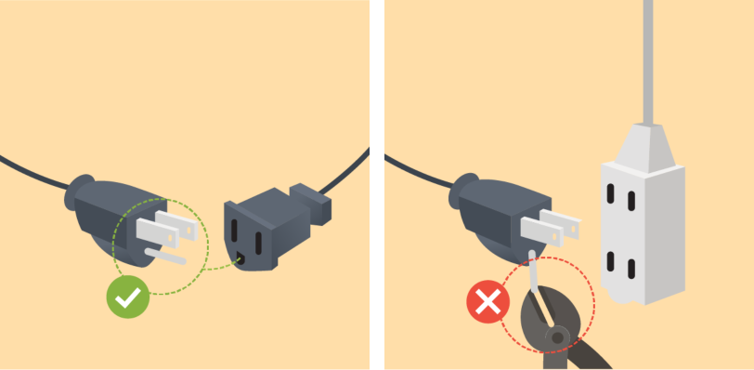
Water + Electricity = Danger!
Never throw water on an outlet that’s on fire

Slide 24
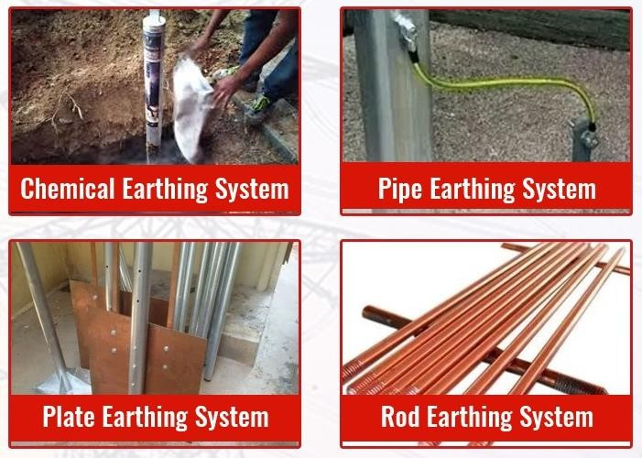
Earthing and its types

Slide 25
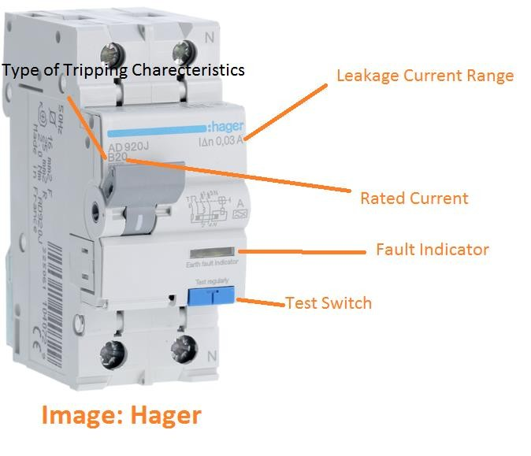
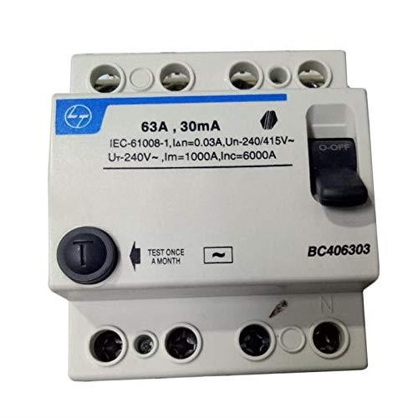
Residual Current Circuit Breaker (RCCB)

Slide 26


